Slide 1
PFI Handover
Solving the problem of managing the handover of PFI Contracts back to the owner
Explore more >

Slide 2



Summary
Flow AI delivers a secure, scalable, and structured archive digitisation service, transforming physical records into high-quality, fully searchable digital assets.
The objective of this engagement is to enable efficient access to documentation while maintaining strict adherence to information governance requirements.

Slide 3
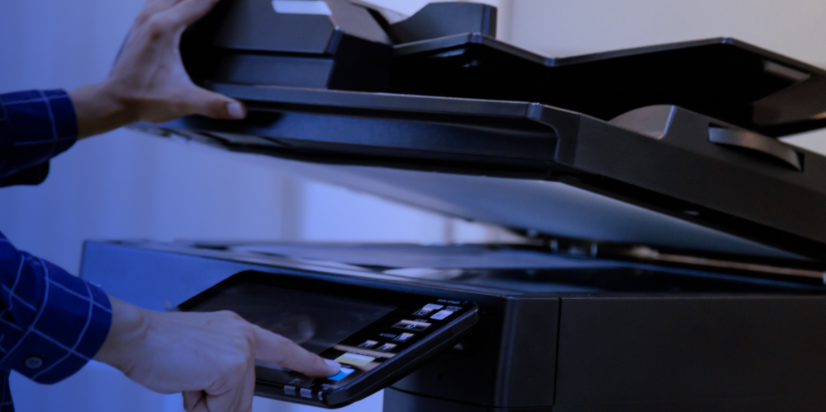





Scan historial documents making all your information digital
Capture digitised information from all sources (incl paper)
Consolidate data into a central Microsoft Native Enterprise Solution (ECM)
Digitise
Capture
Consolidate
Create digital outputs with consistent naming conventions and metadata
Index and Extract relevant metadata and make all files searchable
Eliminate digital document silos through automated file management

Slide 4






Our Scope is a full lifecycle Digitisation service
This approach ensures a consistent, auditable process across all batches processed
Secure collection and transportation of archive materials
Document preparation (medium complexity level)
High-quality scanning and OCR processing
Manual indexing aligned to defined metadata fields
Reconstruction and secure return of physical records
Upload of digital outputs into ViewPoint
Scan historial documents making all your information digital
Capture digitised information from all sources (incl paper)
Consolidate data into a central Microsoft Native Enterprise Solution (ECM)
Digitise
Capture
Consolidate
Create digital outputs with consistent naming conventions and metadata
Index and Extract relevant metadata and make all files searchable
Eliminate digital document silos through automated file management

Slide 5


Mobilisation
Set up, onboarding, workflow
Mobilisation
Set up, onboarding, workflow
Digitisation
Preparation, scanning, and indexing
Digitisation
Preparation, scanning, and indexing
Key Stages of our Service Delivery Model
Verification
Quality assurance and validation checks
Verification
Quality assurance and validation checks
Digital Transfer
Secure upload into ViewPoint
Digital Transfer
Secure upload into ViewPoint
Demobilisation
Project closure and document return
Demobilisation
Project closure and document return

Slide 6

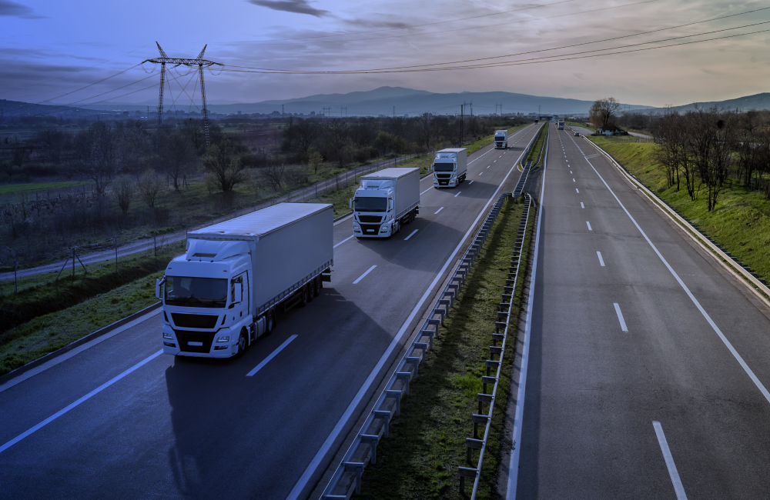

A full chain-of-custody audit trail is maintained at every stage, including location, time, date, and personnel access records.
Secure document transportation
Unique tracking identifiers
Box-level tracking
Mobilisation
Set up, onboarding, workflow
Mobilisation
Set up, onboarding, workflow
Digitisation
Preparation, scanning, and indexing
Digitisation
Preparation, scanning, and indexing
Verification
Quality assurance and validation checks
Verification
Quality assurance and validation checks
Digital Transfer
Secure upload into ViewPoint
Digital Transfer
Secure upload into ViewPoint
Demobilisation
Project closure and document return
Demobilisation
Project closure and document return

Slide 7





Document preparation
Preparation will be carried out in accordance with Medium-level SOP requirements, including:
Removal of staples, clips, and bindings
Separation and inspection of pages
Identification of fragile or complex documents
Special handling workflows are applied for delicate or problematic documents to preserve document integrity.
Repair of damaged materials where required
Introduction of batch headers and control sheets

Slide 8





Scanning & Image Capture
Blank page removal (Controlled Threshold)
Double-sided scanning (default)
Image enhancement (deskew, rotation, edge cleanup)
300 dpi resolution (standard)
Auto colour detection (mono, greyscale, colour per page)
Screening will be performed using production-grade capture technology with the following configuration.

Slide 9


Scanning and Image Capture
Outputs of scanning will be:
Multi-page PDFs per document
Fully OCR searchable
Optimised for storage and ViewPoint ingestion
For documents unsuitable for standard scanners, overhead scanning techniques will be used to ensure capture without risk of damage.

Slide 10
Field 1
Building
Scanning and Image Capture
Indexing
Outputs of scanning will be:
Field 2
Document function
Indexing will be carried out via manual single-key entry, aligned to SOW requirements.
File Naming Convention:
Field1_Field2_Field3_Field4_Field5.pdf
Field 3
Document title (Primary)
Multi-page PDFs per document
Fully OCR searchable
Optimised for storage and ViewPoint ingestion
Field 4
Document title (Secondary)
For documents unsuitable for standard scanners, overhead scanning techniques will be used to ensure capture without risk of damage.
Field 5
Document date

Slide 11
Flow AI Quality Checks
Combined records
Field 1
Building
Indexing
Other
Missing pages
Each scanned image is initially quality checked as it is being scanned by the scanning specialist. Digital unitisation is automatically conducted by Flow AI’s capture suite platform using the batch and transaction header sheets added during the preparation process.
Following the completion of the scanning and unitisation process, documents will undergo an image and record quality check by a Flow AI scanning specialist. The following information is looked for during the image quality check processes.
Field 2
Document function
Indexing will be carried out via manual single-key entry, aligned to SOW requirements.
File Naming Convention:
Field1_Field2_Field3_Field4_Field5.pdf
Folds or post-it notes on docs
Lack of section splitters
Field 3
Document title (Primary)
Poor quality scans
Double scans
Field 4
Document title (Secondary)
Skewed or rotated image
Too light/dark images
Field 5
Document date

Slide 12



Digital transfer
All validated outputs will be:
Delivered directly into your internal systems
Structured according to agreed folder hierarchy
Uploaded on a batch completion basis
Digital files will be securely retained for 30 days post-upload before deletion.

Slide 13

Demobilisation
In line with Flow AI’s data retention policy, all processing files (temporary files) created during the scanning, QC and indexing workflow are automatically deleted following the final output to PDF image and CSV data files.
Upon instruction by our clients, digital output files (PDF and CSV) will be securely deleted from Flow AI’s system and verification provided in writing. Flow AI will expect to receive written instruction to securely delete the digital records within one month of project completion.
Upon completion, the audit log is updated to record the date, time and personnel that conducted the deletion. Flow AI will securely store a copy of the audit log in line with our own document retention policies.

Slide 14

Our approach ensures
Secure handling and full auditability
High-quality, OCR-enabled outputs
Consistent indexing and file structuring
Seamless integration with ViewPoint
Flexible delivery via London-based operations

